Slide 1

Cohort: S24
Course name: Web Engineering
Professor: Clément ZIANE
https://www.datasciencetech.institute

Slide 2



Web Engineering
Introduction to Web

Slide 3
Summary
Introduction
HTML & CSS
HTML
CSS
JavaScript
ASP.NET
MVC
API
3

Slide 4
Web Structure (1/2)
Web Application
Browser
http request
Web Server
http response
Static files
4

Slide 5
Web Structure(2/2)
Front End
HTML
CSS
JavaScript
Back End
Asp.net
Nod.js
PHP
5

Slide 6
Front end
Front-end web development is the development of the graphical user interface of a website.
Tools :
HTML (HyperText Markup Language)
CSS ( Cascading Style Sheets)
JavaScript
so that users can view and interact with that website.
6

Slide 7
Back end
Back-end web development is the development of the server (core) part of a web application/site.
Tools :
PHP
Node.JS
ASP.net
Return the final content for the web browser
7

Slide 8
Web Engineering
HTML

Slide 9
What is HTML ?
The HyperText Markup Language or HTML is the standard markup language for documents designed to be displayed in a web browser.
Based on XML
9

Slide 10
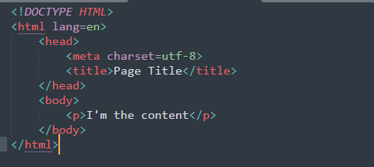
HTML Example
10

Slide 11
HTML Tags
Each tags have a meaning :
Find list of tags here
Do not use tags for styling but only for semantics
11

Slide 12
Attributes
HTML attributes provide additional information about HTML elements. Examples :
class (identify a group of element)
id (unique)
name
12

Slide 13
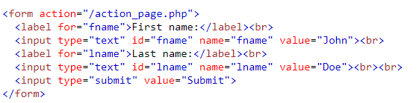
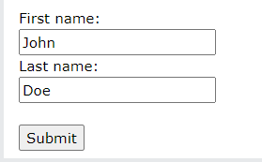
Form : Communicate with back end
13

Slide 14
Web Engineering
CSS

Slide 15
CSS Definition
Cascading Style Sheets (CSS) is a style sheet language used for describing the presentation of a document written in a markup language such as HTML.
Use selectors
Style description
15

Slide 16
How ?
Internal CSS Inside HTML file (in header) using style tag
External CSS Separate file included via link tags in our html file
Inline Style Directly inside html element with attribute style
16

Slide 17
Example
p{
width : 100%
}
Inline example :
<p style="width:100%“> Hello </p>
17

Slide 18
Relative vs Absolute
It’s about positioning of elements :
Relative refer to parent element
Absolute refer to the whole document
18

Slide 19
Relative values vs fixed values (1/3)
Relative values in CSS are values that adjust based on another element or the viewport. They are flexible and change depending on the context. Here are common examples:
Percentage (%): Size based on a percentage of the parent element’s dimensions (width, height, padding, margin, etc.).Example: width: 50% means the element’s width is 50% of its parent’s width.
Em and Rem:
Em: Relative to the font size of the element or its parent (if nested). For example, 2em means twice the size of the current font size.
Rem: Relative to the root element’s font size (<html>). 1rem is equal to the font size of the root element, making it consistent across the page.
Viewport Units:
vw (viewport width): Relative to 1% of the viewport width.
vh (viewport height): Relative to 1% of the viewport height.
19

Slide 20
Relative values vs fixed values (2/3)
Absolute values in CSS are fixed and don’t change based on parent or viewport size. They provide a precise measurement that remains the same across different contexts. Examples include:
Pixels (px): Fixed number of pixels. For example, width: 100px will always render as 100 pixels wide, regardless of the viewport or parent size.
Points (pt), centimeters (cm), inches (in): Primarily used in print media, these are also fixed and rarely used in web layouts due to their inflexibility.
20

Slide 21
Relative values vs fixed values (2/3)
When to Use Each
Use relative values when you want your design to adapt to different screen sizes and layouts (responsive design).
Use absolute values when you need fixed sizes, such as for small interface icons or specific layout elements where precision is key.
21

Slide 22
Colors
RGB : Red Green Blue Hexadecimal : #RRGGBB
RGBA : Red Green Blue Alpha Alpha is for transparency
22

Slide 23
Questions ?
Ask them all !

